Slide 1

What’s new in ASP.NET Core 3.x
Scott Addie
@Scott_Addie
Notes:
Released on 9/23

Slide 2



.NET Framework unsupported
WebApp.csproj
<Project Sdk="Microsoft.NET.Sdk.Web"> <PropertyGroup> <TargetFramework>netcoreapp3.0</TargetFramework> </PropertyGroup> </Project>
<Project Sdk="Microsoft.NET.Sdk.Web"> <PropertyGroup> <TargetFramework>net461</TargetFramework> </PropertyGroup> <ItemGroup> <PackageReference Include="Microsoft.AspNetCore" Version="2.2.0" /> <PackageReference Include="Microsoft.AspNetCore.HttpsPolicy" Version="2.2.0" /> <PackageReference Include="Microsoft.AspNetCore.Mvc" Version="2.2.0" /> </ItemGroup> </Project>
.NET Standard 2.0
.NET Standard 2.1
Notes:
ASP.NET Core 3.0 built on .NET Standard 2.1
C# 8 support (async streams & nullable reference types)
.NET Standard is first version to NOT support .NET Framework

Slide 3
Supported ASP.NET Core variants
2.2 on .NET Core 2.2
2.1 on .NET Core 2.1
2.1 on .NET Framework 4.6.x
3.0 on .NET Core 3.0
3.1 on .NET Core 3.1
LTS
Maint.
EOL
LTS
LTS
Notes:
LTS = support for 3 years after initial release
3.0 support ends 3/3
2.2 support ended 12/23

Slide 4
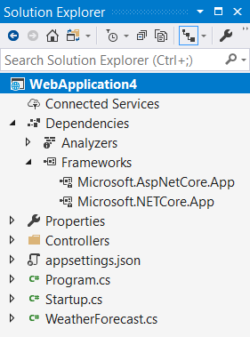
Implicit shared framework reference
Web SDK includes the following:
<ItemGroup>
<FrameworkReference Include="Microsoft.AspNetCore.App" />
</ItemGroup>
Remove metapackage reference when migrating:
<ItemGroup>
<PackageReference Include="Microsoft.AspNetCore.App" />
</ItemGroup>
Notes:
Distribution as framework instead of NuGet package
Library authors may need to use this

Slide 5

Assemblies removed from shared framework
Json.NET
Web API Client (Microsoft.AspNet.WebApi.Client)
Roslyn (Microsoft.CodeAnalysis.*)
EF Core
Identity UI
Social auth
Node Services & SPA Services
Notes:
Json.NET: System.Text.Json instead (based on Span<T>)
WebApi.Client: had a dependency on Json.NET
Roslyn:
ships on the VS schedule, which differs from the .NET Core release lifecycle
some customers don’t want compilers in the runtime (for security reasons)
These customers think compilers should ONLY be in SDK
Roslyn was there to support features like Razor view compilation at runtime
Social auth: Facebook, Google, Microsoft, Twitter
These are NuGet packages now (previously part of shared framework in 2.x)
SPA Services: removal in .NET 5 (use SPA CLIs instead)
SpaServices.Extensions package still supported integration mechanism
.SpaServices & .NodeServices unnecessary since ASP.NET Core 2.1
C:\Program Files\dotnet\shared\Microsoft.AspNetCore.App

Slide 6
Endpoint routing
Decouples route matching from MVC middleware
Route resolution occurs earlier in pipeline
2.2 (IRouter-based)
app.UseMvc();
app.UseSignalR(routes =>
routes.MapHub<DrawHub>("/draw"));
3.0 (Endpoint-based)
app.UseRouting();
app.UseEndpoints(endpoints =>
{
endpoints.MapRazorPages();
endpoints.MapHub<DrawHub>("/draw");
});
Notes:
2.2 apps can opt in (MVC only); default in 3.0
Replaces legacy IRouter API
Dedicated middleware
Project Houdini work:
Routing becomes core platform feature instead of app model feature
No longer MVC-specific (SignalR had its own routing system in 2.2)
Map the following:
Controllers (MVC or web API)
Razor Pages
Health check endpoints
gRPC services
SignalR hubs

Slide 7
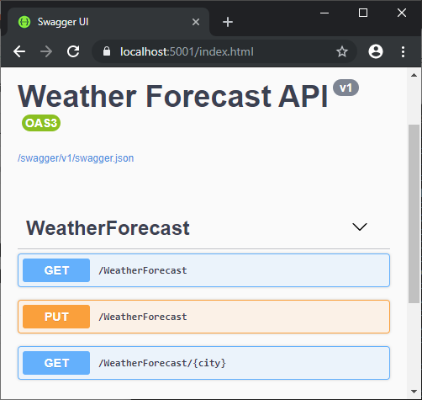
HTTP REPL
Command-line HTTP testing
Localhost
Cloud-hosted
Azure App Service
Azure Functions
Azure REST API
Endpoint navigation
Requires Swagger / OpenAPI definition
AuthN / AuthZ support
.NET Core Global Tool:
dotnet tool install -g Microsoft.dotnet-httprepl
Notes:
Requires .NET Core 2.1+
Auth schemes achievable via header manipulation
Basic authN
JWT bearer tokens
Digest authN

Slide 8

Notes:
Added Swashbuckle to starter API project

Slide 9
Developer Exception Page plain-text support
[ApiController]
[Route("[controller]")]
public class WeatherForecastController : ControllerBase
{
[HttpGet("{city}")]
public ActionResult<WeatherForecast> Get(string city)
{
if (!string.Equals(city?.TrimEnd(), "Redmond",
StringComparison.OrdinalIgnoreCase))
{
throw new ArgumentException(
$"Weather forecast unavailable for {city}.", nameof(city));
}
return GetWeather().First();
}
Notes:
Startup.Configure:
if (env.IsDevelopment())
{
app.UseDeveloperExceptionPage();
}

Slide 10

Plain-text response
cmd - httprepl
https://localhost:5001/weatherforecast> GET Chicago HTTP/1.1 500 Internal Server Error Content-Type: text/plain Date: Wed, 02 Oct 2019 01:50:48 GMT Server: Kestrel Transfer-Encoding: chunked System.ArgumentException: Weather forecast unavailable for Chicago. (Parameter 'city') at WebApplication3.Controllers.WeatherForecastController.Get(String city) in C:\Users\scaddie\source\repos\WebApplication3\Controllers\WeatherForecastController.cs:line 35 at lambda_method(Closure , Object , Object[] ) at Microsoft.Extensions.Internal.ObjectMethodExecutor.Execute(Object target, Object[] parameters)
Notes:
Plain text = default media type in 3.0

Slide 11
HTML response
cmd - httprepl
https://localhost:5001/weatherforecast> GET Chicago -h Accept=text/html HTTP/1.1 500 Internal Server Error Content-Type: text/html; charset=utf-8 Date: Wed, 02 Oct 2019 02:07:06 GMT Server: Kestrel Transfer-Encoding: chunked <!DOCTYPE html []> <html lang="en" xmlns="http://www.w3.org/1999/xhtml"> <head> <meta charset="utf-8" /> <title>Internal Server Error</title> <style> body { font-family: 'Segoe UI', Tahoma, Arial, Helvetica, sans-serif; font-size: .813em;
Notes:
Set Accept header to opt into HTML response
HTML was ONLY supported media type in < 3.0

Slide 12

gRPC
Contract-based RPC services
Messages sent/received via HTTP/2
Services & messages defined with Protobuf
Binary serialization
Notes:
Conceptually similar to WCF & .NET Remoting
We’re contributing to the open source gRPC project (https://github.com/grpc/grpc-dotnet)
In PROD, configure TLS (Transport Layer Security) to secure messages
Can’t host in Azure App Service or IIS (Http.Sys HTTP/2 implementation doesn’t support response trailing headers)
Reduced network congestion thanks to binary serialization

Slide 13

gRPC: Protobuf
exchange_rate.proto
syntax = "proto3"; package contosolending.grpc; service ExchangeRateManager { rpc GetExchangeRate (ExchangeRateRequest) returns (ExchangeRateReply); } message ExchangeRateRequest { string currency_type_from = 1; string currency_type_to = 2; } message ExchangeRateReply { double exchange_rate = 1; }
Notes:
golden Retriever PanCakes
Define contract using Protobuf (it’s an Interface Design Language)
*.proto file lives on server portion (the gRPC service itself)
Clients consume *proto file
There’s no Protobuf type that maps to C# decimal type
Field numbers uniquely identify field values in the message binary format

Slide 14
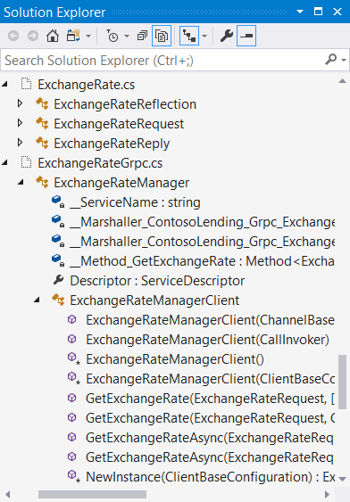
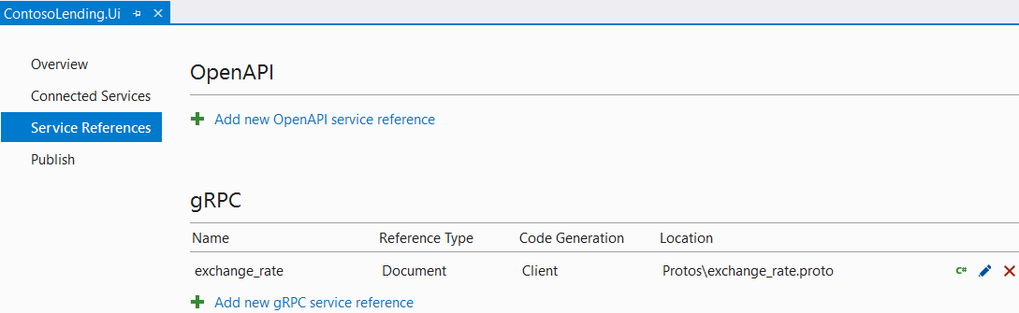
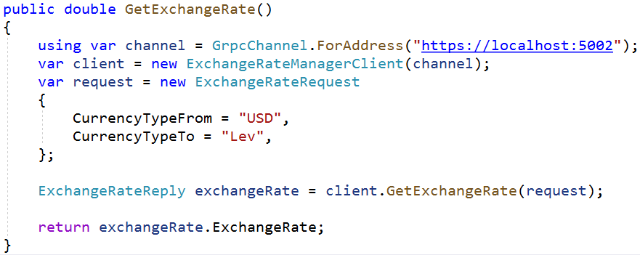
gRPC: The client
Notes:
Snake casing in *proto file converted to appropriate C# Pascal casing
Use generated members to interact w/ gRPC service
Generators for other languages (Node.js, Go, etc.)

Slide 15



Worker services
Long-running background tasks
Supported by new Worker SDK
public static IHostBuilder CreateHostBuilder(string[] args) =>
Host.CreateDefaultBuilder(args)
//.UseWindowsService()
//.UseSystemd()
.ConfigureServices(services => services.AddHostedService<Worker>());
Windows service | Systemd service
Microsoft.Extensions.Hosting.WindowsServices | Microsoft.Extensions.Hosting.Systemd
Notes:
Microsoft.NET.Sdk.Worker
Generic Host instead of Web Host
UseSystemd ignored on Windows host & UseWindowsService ignored on Linux host
Low-level building block for higher-level frameworks like Hangfire
Hangfire is more feature-rich
Technically not a web thing, but owned by ASP.NET team

Slide 16
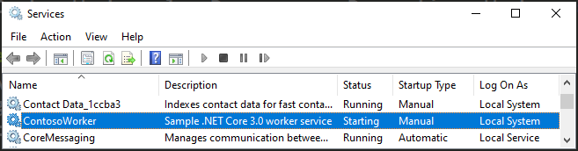
Worker service as a Windows service
> dotnet publish -o C:\pub
> sc create ContosoWorker binPath=C:\pub\ContosoWorker.exe
> sc description ContosoWorker “Sample .NET Core 3.0 worker service”
> sc start ContosoWorker
Notes:
Publish app as .exe & run Service Control Mgr. tool to create Win. service
sc.exe create <service name> <exe file path>

Slide 17
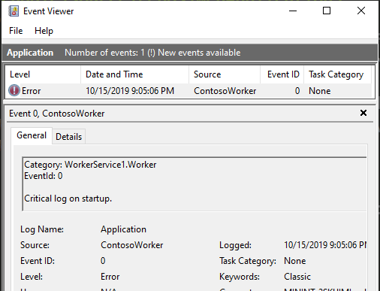
Worker service logging
public class Worker : BackgroundService
{
private readonly ILogger<Worker> _log;
public Worker(ILogger<Worker> log) =>
_log = log;
protected override async Task
ExecuteAsync(CancellationToken token)
{
_log.LogCritical(
"Critical log on startup.");
Notes:
Publish app as .exe & run Service Control Mgr. tool to create Win. service
sc.exe create <service name> <exe file path>

Slide 18
Other noteworthy features
Blazor (server-side)
SignalR auto-reconnects
SignalR client-to-server streaming
SignalR hub policies
OpenAPI integration
IdentityServer integration
Notes:
Blazor WASM based on Mono WASM runtime
Blazor Server based on .NET Core runtime
Hub authZ policy support

Slide 19
Blazor, gRPC, SignalR
DEMO
Notes:
Server-side Blazor
gRPC client & server
SignalR auto reconnect
Endpoint routing

Slide 20
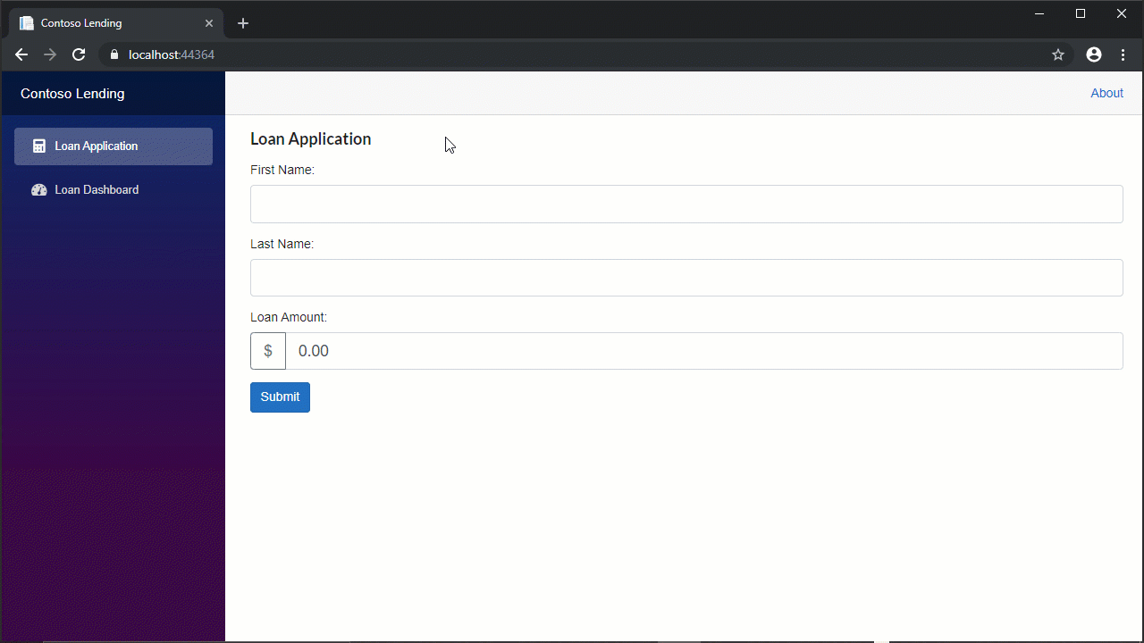

Slide 21
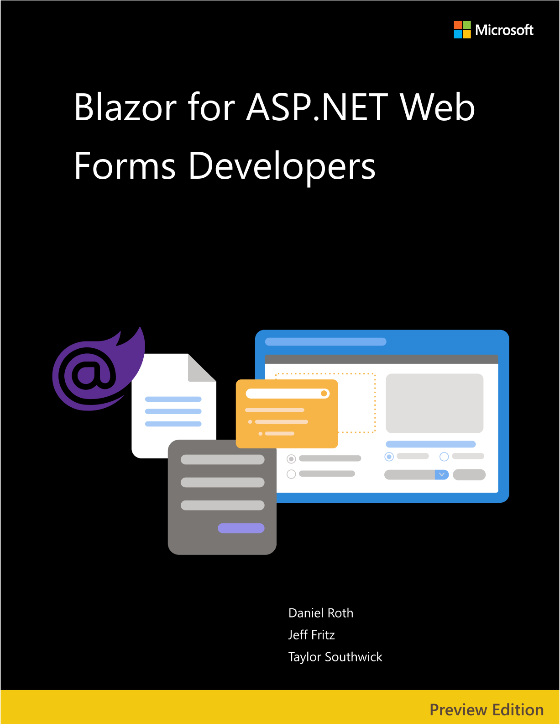
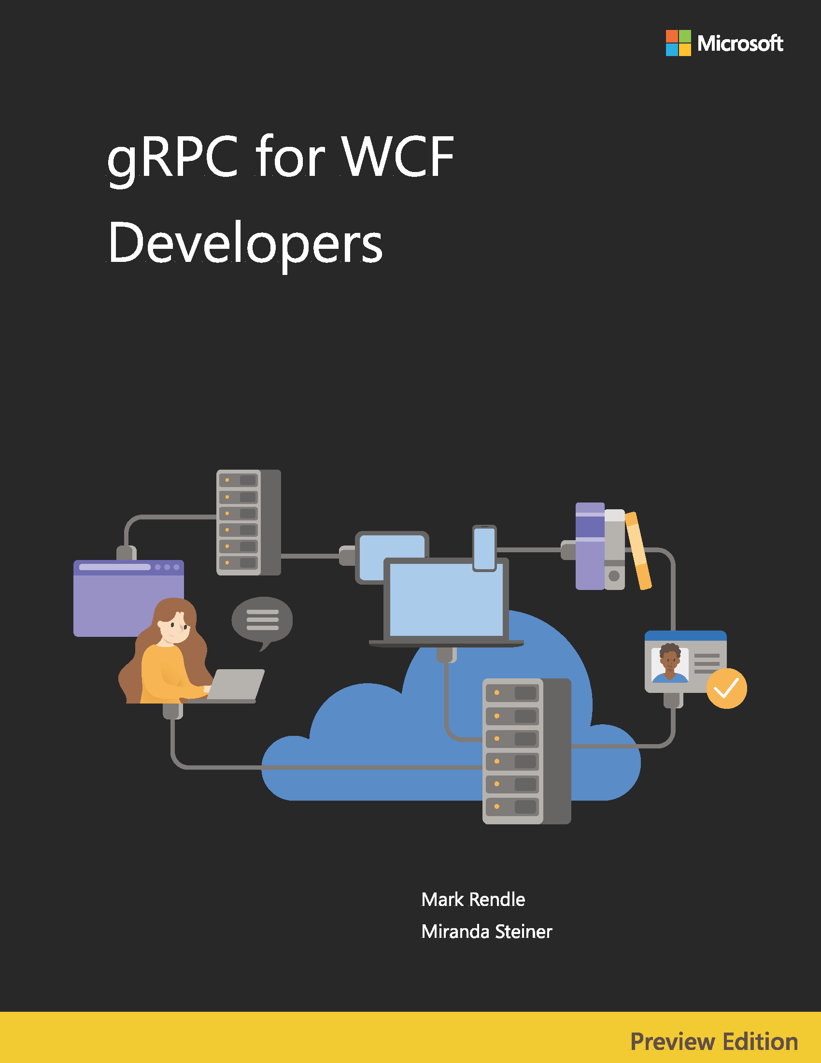

Resources
eBooks
docs.microsoft.com/dotnet/architecture/
Migration guide
aka.ms/migrate-to-3.0
Slides
aka.ms/new-in-aspnetcore3
Code
aka.ms/contoso-lending
Socials
@Scott_Addie

